Slide 1

AI BASED FRAUD DETECTION SYSTEM
Mentor : Mr.Anurag Sharma
Presented By : Group 2
Team Members : Gunjan Aggarwal
Tvesa Gupta
Shaili Chauhan
Umarani Muthukrishnan
Hemasri Vodnala

Slide 2
1
PROBLEM
Financial fraud disproportionately affects women, making secure banking essential. Traditional methods fail to detect threats in real time. This AI-driven system analyzes transaction patterns, detects anomalies, and instantly flags suspicious activities to protect women's accounts from fraud.
GBS Diversity Hackathon | 2025

Slide 3
2
PROPOSED SOLUTION
1
AI & ML-Based Fraud Detection – Uses Random Forest to analyze transaction patterns and flag fraudulent activities in real-time.
GBS Diversity Hackathon | 2025
Secure & Scalable System – Implements Flask/Express.js backend, React.js/Vue.js frontend, cloud deployment, and security measures like encryption & 2FA.
2
3
Real-Time Alerts & Chatbot – Notifies users instantly about suspicious transactions and integrates a chatbot with generative AI for assistance.

Slide 4
3
WORK FLOW
Yes
Data Processing
AI Analysis
Suspicious?
Alert User
No
Ok
Transaction
Process
Approve
Verify
Complete
Fraud
Block
Update AI
Diversity Hackathon | 2025

Slide 5
4
TECH STACK
Front-end :
HTML, CSS, JavaScript
GBS Diversity Hackathon | 2025
Database :
Flask with SQLAlchemy
Back-end :
Flask with SQLAlchemy
Platforms :
Canva (Design), VS Code (Code Editor)
AI/ML :
Google Colab (for model training & testing)

Slide 6
5
FUTURE SCOPE
Graph-Based Fraud Detection – Uses GraphDB (Neo4j) to identify hidden fraud networks by analyzing transactional relationships (e.g., linked fraudulent accounts).
Enhanced RL Model – Continuously refines fraud detection strategies using Reinforcement Learning to adapt to new fraud patterns.
GBS Diversity Hackathon | 2025

Slide 7
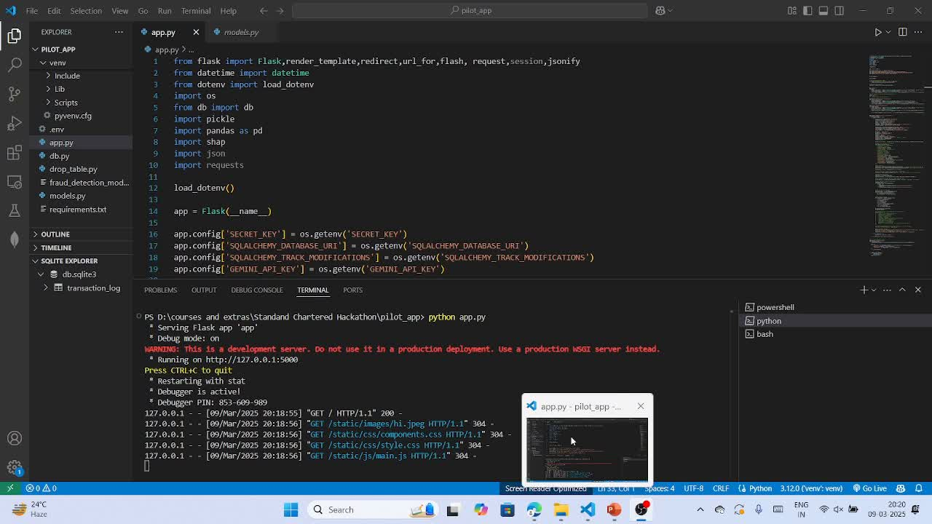
6
DEMO
Diversity Hackathon | 2025

Slide 8
THANK YOU

